Slide 1

Performance Analysis of Multi-Model Transformer Architectures for classical Arabic Author Identification

Slide 2
Introduction

Slide 3
The core problem we address is Authorship Identification (AID) within a multiclass classification framework. Specifically, given a text excerpt of unknown origin, the system must accurately attribute it to one of 21 candidate authors from the AbjadAuthorID EACL 2026 shared task.
Problem Statements

Slide 4

Related work
Thynk Unlimited
  Evolution of Writing Style Analysis: The field has progressed from traditional machine learning techniques, such as SVMs relying on n-grams and punctuation features, to deep learning models like CNNs and LSTMs. More recently, transformer-based models such as BERT have become the dominant approach, as they more effectively capture complex contextual patterns and authorial writing style.
  The Arabic Linguistic Challenge: Authorship Identification in Arabic is uniquely difficult due to its rich morphology and orthographic variability (diacritics/elongations). This necessitates language-specific models like AraBERT, which provides specialized preprocessing to normalize and segment these complex structures.

Slide 5
Contribution

Slide 6
  Comparative 3-Experiment Framework: Evaluated three distinct architectures to find the optimal solution: AraBERT, MARBERT, and Zero-shot Large Language Models (LLMs), providing a comprehensive analysis of their performance in Arabic authorship attribution.
  Custom Architectural Engineering: Developed a Sliding Window strategy (128-stride) to preserve context in long-form prose and implemented Weighted Loss to ensure classification fairness across imbalanced datasets.
  State-of-the-Art Results: Achieved a peak Accuracy of 90% and 87% Macro-F1, outperforming LLM baselines and securing 3rd Place globally in the AbjadAuthorID EACL 2026 competition.

Slide 7
Methodology

Slide 8
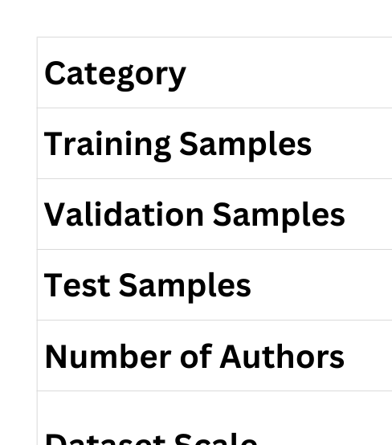
Dataset Description

Slide 9
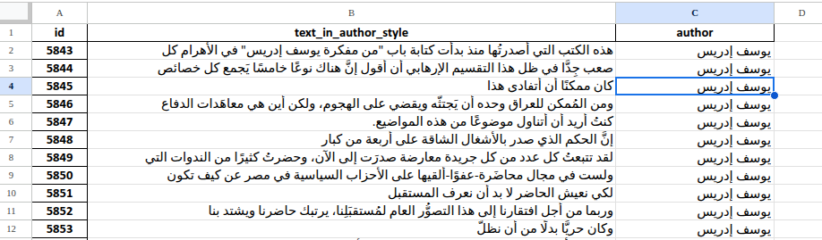

Slide 10
Dataset Problem
Identified 3major problems during the data exploration phase:
  Class Imbalance: The number of samples per author is not equal. Some authors have a vast amount of data, while others have very few.
    Impact: This could lead the model to "bias" towards majority authors.
  Length Variability & Truncation:
    Many text excerpts were much longer than the standard transformer limit (512 tokens).
    Impact: A significant portion of the text might be lost if not handled properly (Leading to the trade-off between Truncation in AraBERT vs. Sliding Window in MARBERT).
  Orthographic Noise:
    Arabic text often contains inconsistencies in character normalization (e.g., variations of أ, ا, إ and ى, ي).
    Impact: If not normalized, the model might treat the same word as two different words, confusing the stylistic analysis.
AI Transforming Finance

Slide 11
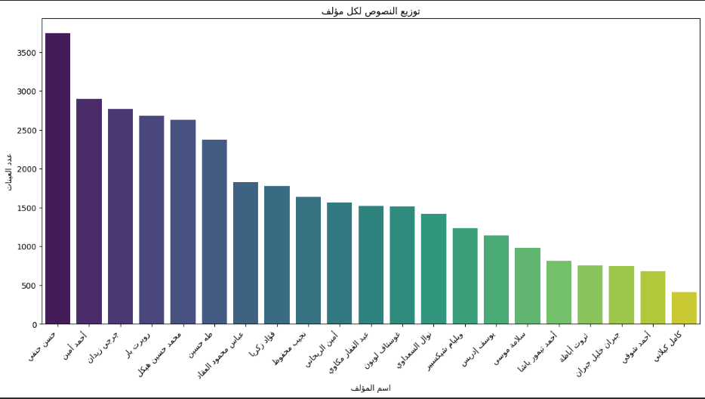

Slide 12
Thynk Unlimited
We conducted three experiments to identify the best stylistic fit for Arabic author profiling:
  MARBERTv2: A SOTA Arabic Transformer designed primarily for social media and dialectal Arabic.
  AraBERTv2 (Best Performing): A SOTA Arabic Transformer optimized for Modern Standard Arabic (MSA) and formal prose.
  Zero-Shot LLM Prompting: using LLMs without task-specific fine-tuning to evaluate stylistic attribution in a zero-shot setting.

Slide 13
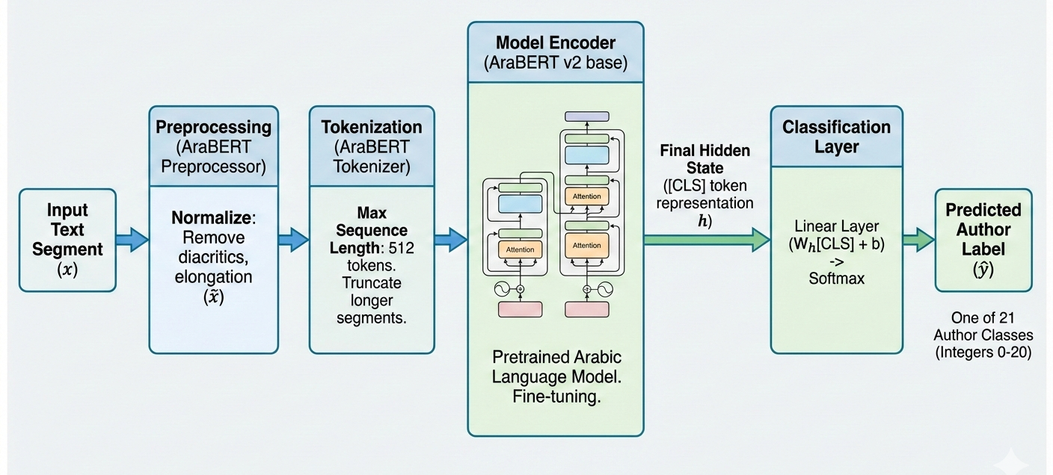
Proposed Pipeline -Best Experiment

Slide 14
Experiment 1: MARBERT v2 Fine-tuning

Slide 15
First Approach
  Model Configuration
    Fixed sequence length of 512 tokens
    No overlap between segments (no sliding window)
  Training Parameters
    Trained for 3 epochs
  Results
    Accuracy: 87%
    Macro F1-score: 80%
  Insight
    While these results were strong, we realized that by not using an overlap, the model was potentially missing stylistic transitions between text segments, leading to a loss of contextual flow that defines an author's unique "fingerprint”.

Slide 16
Second Modified Approach
  Handling Long-Form Text (Sliding Window)
    Implemented custom tokenization using a 512-token window with 256-token overlap
    Preserved contextual continuity across long documents
  Addressing Class Imbalance (Weighted Trainer)
    Designed a custom WeightedTrainer by overriding compute_loss
    Applied class-weighted cross-entropy loss to emphasize minority authors
    Reduced bias toward majority classes and improved training stability
  Performance Impact
    Macro F1-score: 84%
    Accuracy: 88%
    Achieved stable and balanced classification performance

Slide 17
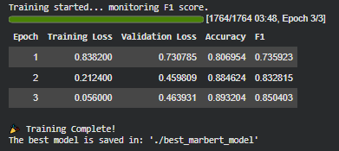

Slide 18
Experiment 2: AraBERT v2 Fine-tuning

Slide 19
Experiement 2- AraBERTv2 Model Implementation:
Thynk Unlimited
  Model Backbone
    Built on AraBERTv2-base, specifically optimized for Modern Standard Arabic (MSA)
  Data Preprocessing
    Applied the official AraBERT preprocessing pipeline
    Removed Tashkeel, Tatweel, and normalized Arabic text
  Optimized Training Setup
    Learning rate: 2e-5 for stable and efficient convergence
    Tokenization stride: 128 tokens to preserve contextual continuity while maintaining computational efficiency
  Final Results
    Accuracy: 90%
    Macro F1-score: 87%
    Achieved 3rd Place in the workshop competition

Slide 20
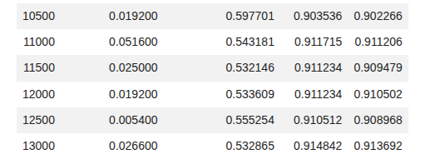
Experiement 2- AraBERTv2 Model Implementation:
Thynk Unlimited

Slide 21
Experiment 3: Zero-Shot LLM-Based Prompt Engineering

Slide 22
Experiement 3- Zero Shot Prompting:
Thynk Unlimited
  Experimental Setup:
    Zero-shot prompt classification using a Deepseek v3.2 LLM
    No fine-tuning; relied only on prompt engineering
    The author's name (target) was defined in the prompt, and based on the Text the LLM was supposed to define to which author this belongs.
  Results:
    Accuracy: 12.53%
    F1-score: 5.57%
  Main Insight
    Zero-shot LLMs are not well-suited for authorship attribution tasks
    Capturing an author’s stylistic “fingerprint” requires task-specific training
    Highlights the important of fine-tuning domain-specific models for stylistic analysis

Slide 23
Prompt:
Thynk Unlimited
أنت خبير في تحليل الأسلوب الأدبي العربي. مهمتك هي تحديد كاتب النص التالي من بين قائمة من المؤلفين.
قائمة المؤلفين المحتملين: {(authors_list)}
النص المراد تحليله: {text}
قم بتحليل:
1. الأسلوب الأدبي والبلاغي
2. المفردات والتراكيب اللغوية المستخدمة
3. الموضوعات والأفكار المطروحة
4. السمات الأسلوبية المميزة
بناءً على تحليلك، أجب فقط باسم المؤلف من القائمة المعطاة. لا تضف أي تفسيرات أو نصوص إضافية. الإجابة (اسم المؤلف فقط)

Slide 24
Results

Slide 25
Performance Metrics
Thynk Unlimited
  Accuracy: The proportion of total predictions that are correct.
  Weighted F1 Score:
    The average of F1 scores for each individual class, weighted by the number of actual instances (support) of that class..
    Calculates the F1 score for Class A, Class B, etc., separately. Multiplies each score by how many times that class appears in the data.

Slide 26
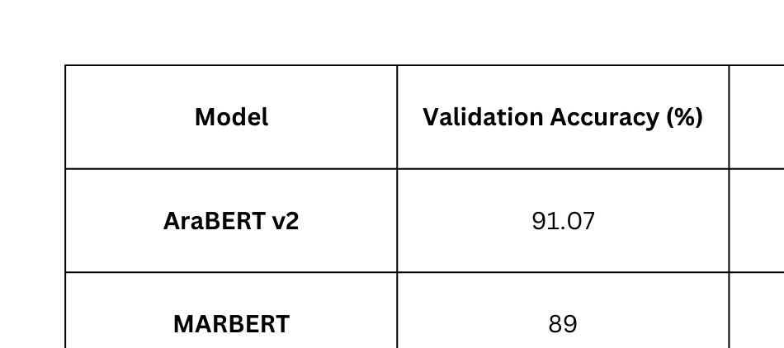
Thynk Unlimited
Performance Comparison

Slide 27
Thank you

